Slide 1
Using IMERG to Define Precipitation Features and their Upscale Growth
Mani Rajagopal and Ed Zipser
Dept. of Atmospheric Sciences, University of Utah
CPEX Science Team Meeting
Seattle, WA, July 17th 2019
Notes:
Hi Everyone, Good Morning
As you know that, IMERG is multi satellite precipitation product available every 30 minutes. This high temporal resolution allows us to track a precipitation system and study its growth

Slide 2
OUTLINE
Tracking of relatively simple cases of 10 June and 11 June
Subjective and objective tracking algorithm results similar; acceptable
Tracking of more complex cases of 06 June and Cindy on 21 June
With many splits and mergers;
Case study: Upscale growth of June 17th system in western Caribbean
What is the optimal precipitation threshold?
Challenges and lessons learned in studying large system with a single aircraft.
Notes:
This Presentation has two parts.
In the First part I will be talking about
Subjective Tracking Method
Objective Tracking Method
How they compare for simple cases like June 10th and June 11th
And For complex cases like June 6th and June 21st.
Second part of the presentation will be given by Prof. Ed Zipser. He will be talking about the upscale growth of June 17th System in western carribean. The challenges and the lessons learnt

Slide 3
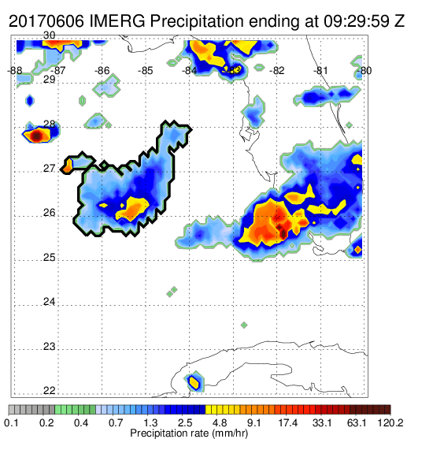
Tracking Methods
Subjective Method:
IMERG precipitation feature (IPF) defined as contiguous precipitation area;
Track forward and backward in time to select, subjectively, the specific area of greatest interest for upscale growth of a large MCS
Notes:
Traditionally the Precipitation feature is defined as contiguous area of
Tb (or)
Reflectivity (or)
Precipitaion
The way I have defined the precipitation feature is looking at the animation like and track the system in time to find
The position and define its boundary
Sometimes it is simple but sometime when there is merger, the boundary is defined subjectively.
After defining the boundary and tracking the system in time we compute parameters like area and Vol. rainrate to see How it evolved in time.

Slide 4
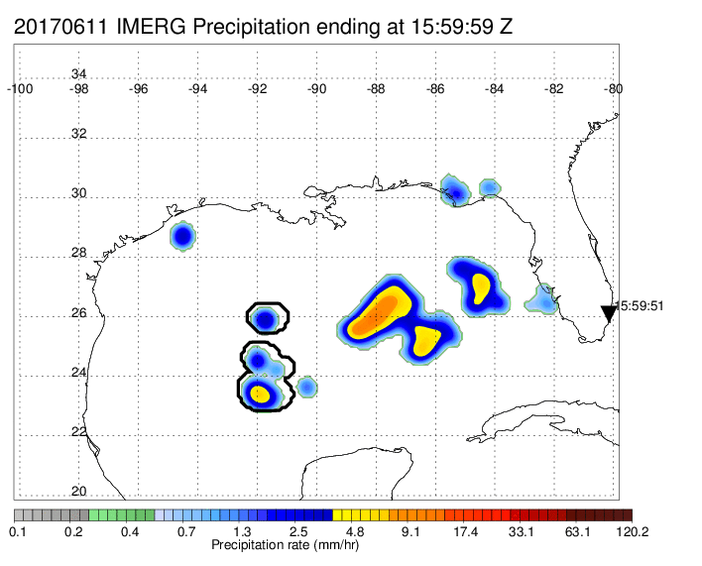
Tracking Methods
Objective Method:
Skok’s forward in time (FiT) tracking algorithm. (Skok et al 2009, 2013)
Objectivity and reproducibility are desirable in science;
Previously used with TRMM 3B42
Handles splits and mergers
Gaussian smoothing function with radius of about 0.8 degree used. (Is this optimum?)
Notes:
For Objective Tracking I use Skok’s Forward in Time algorithm.
We contacted the author and got the program IMERG precipitation data is given as an input to the program and it identifies precipitation object and then tracks it across the different times.
The two reason for using objective tracking is
Reproducibility and
Other is that when we want to track many systems, Objective method is very useful.
The algorithm had been used in previous studies with TRMM 3B42 precipitation data and
Handles Splits and Merger.
The Algorithm requires smoothened precipitation data for it to identify and track precipitation objects.
The way the algorithm works is that

Slide 5
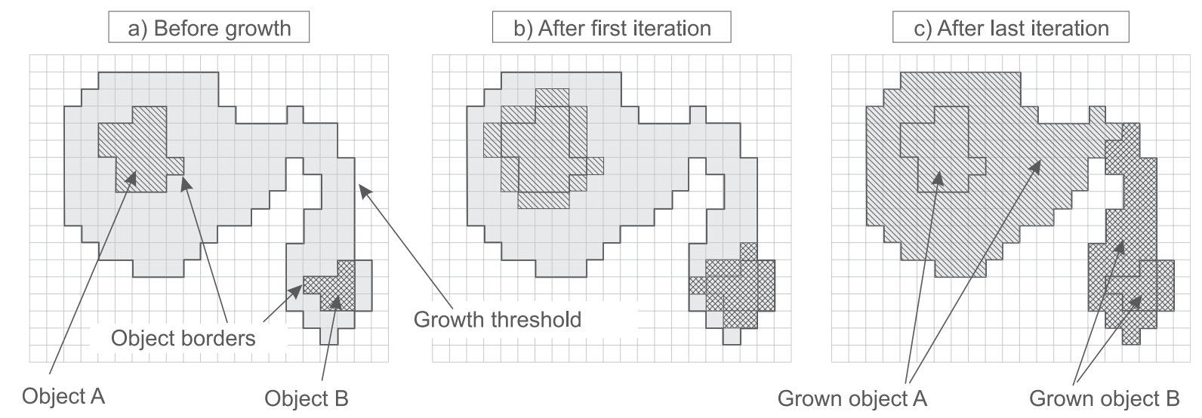
Tracking Methods
Objective Method:
Uses iterative process with multiple precipitation threshold to define the objects
Selects everything within highest threshold (i.e. cores)
Iterative process to grow objects to subsequent thresholds
Connected objects remain as two objects or merge dependent on certain conditions
Fig (1) - Skok et al 2013
Notes:
The way the algorithm works is that it requires a set of precipitation thresholds.
The area above highest threshold is selected as convective cores and the algorithm iteratively connects the moderate and light precipitation.
This process allow a contiguous precipitation area to have multiple object as seen in the figure c.
This method has to tunable parameters
Smoothing radius .
The different thresholds that results in different system boundary.
Lets look at some of the results.

Slide 6
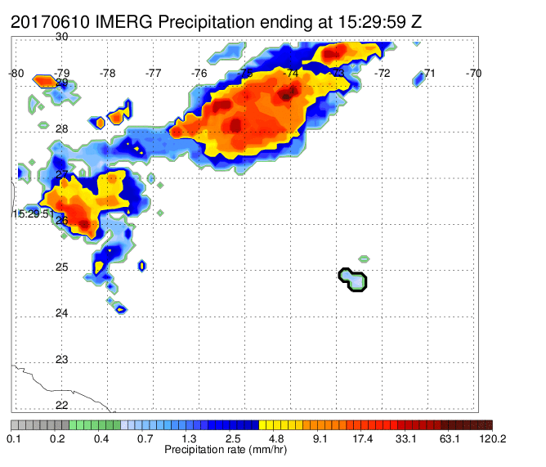
June 10th - IPF Evolution - 0.5 mm Threshold
Subjective
Objective
Isolated system with no splits/mergers. Easy to track.
Objective and Subjective method perform similarly.
Notes:
June 10th is a small MCS but an isolated system.
I will let the animation, go a couple of times and you can see the precipitation field has been smoothened and Objective method tracking without any human input.

Slide 7
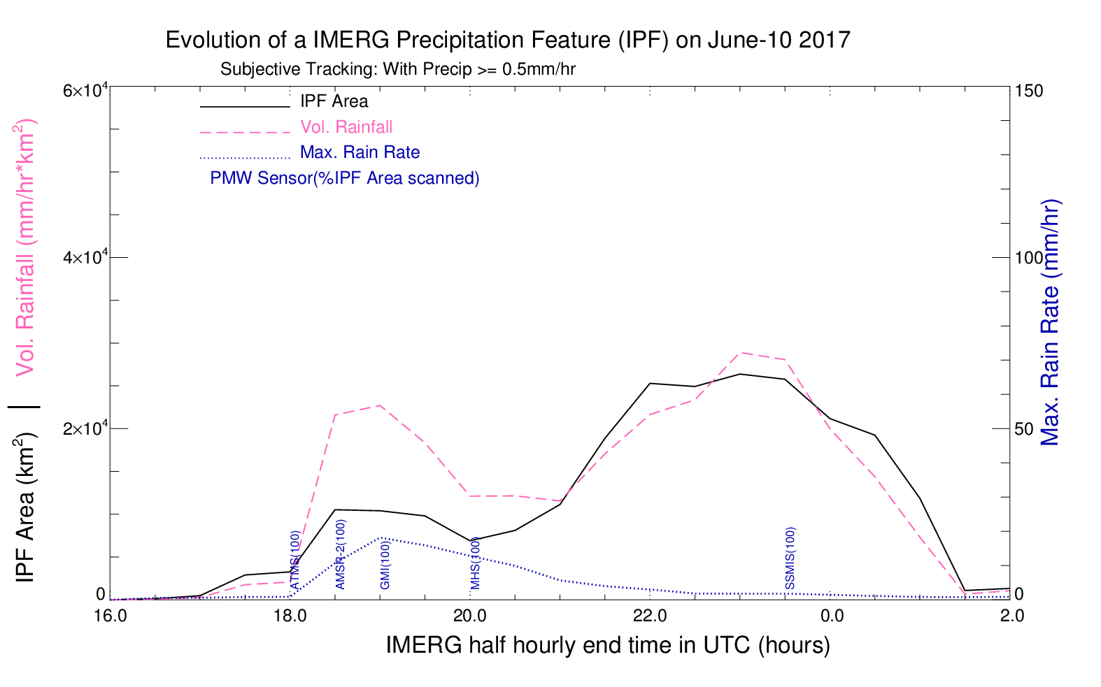
June 10th - IPF Evolution - 0.5 mm Threshold Subjective Method
Vol. rain rate is summation of rain rate X area inside the precipitation feature.
Mean rain rate = Vol. rain rate/ Area
Before 21 Z mean rain rate is > 1.0 mm/hr; after 21 Z < 1.0 mm/hr.
Notes:
After tracking the PF we compute the parameters like area and Vol. Rain
Vol. rain rate is the summation of rain rate * Area at every grid.
On June 10th we could that bedore 21 Z the precipitation is convective with mean rain rate > 1 mm/hr and after that it is stratiform.
I will switch between Subjective and objective method and you can see how similar they are

Slide 8
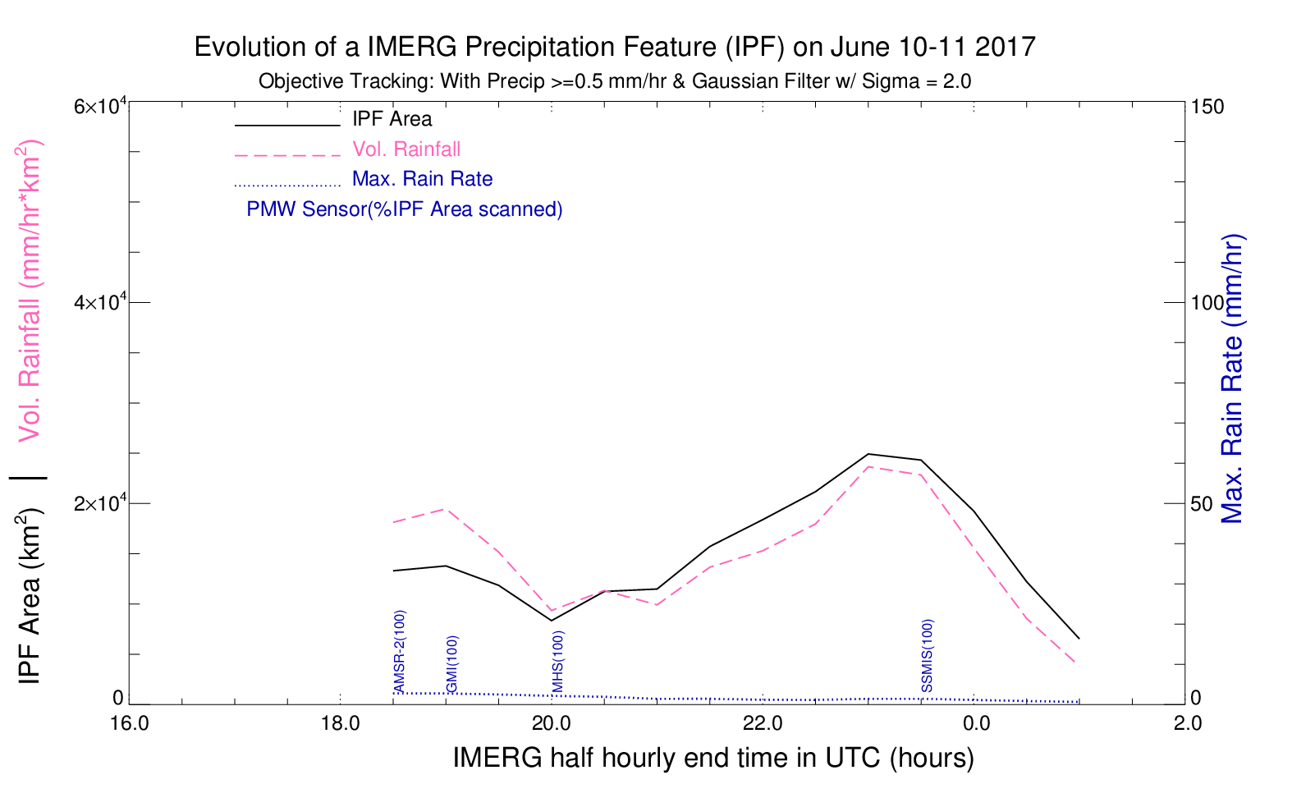
June 10th - IPF Evolution - 0.5 mm Threshold Objective Method
Matches closely with subjective tracking.
Max rain rate dampened due to smoothing.

Slide 9
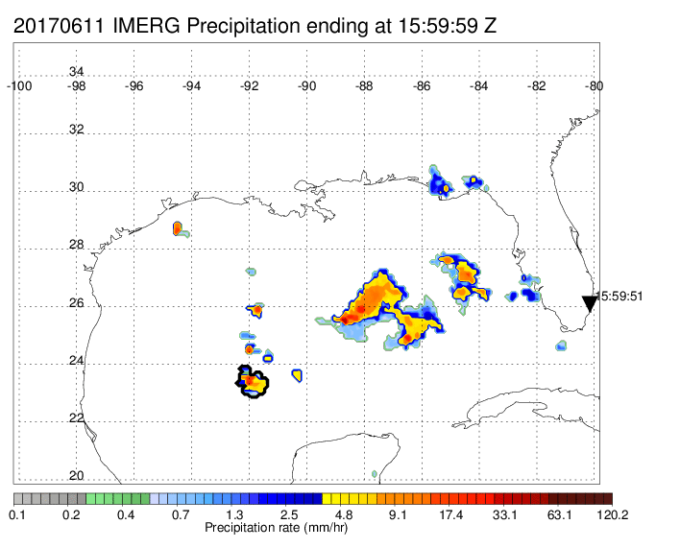
June 11th - IPF Evolution - 0.5 mm Threshold
Subjective
Objective
An example of small system but with some splits and mergers; results still fairly similar
Notes:
Lets look at June 11th Case will some splits and mergers
And the results looks similar

Slide 10
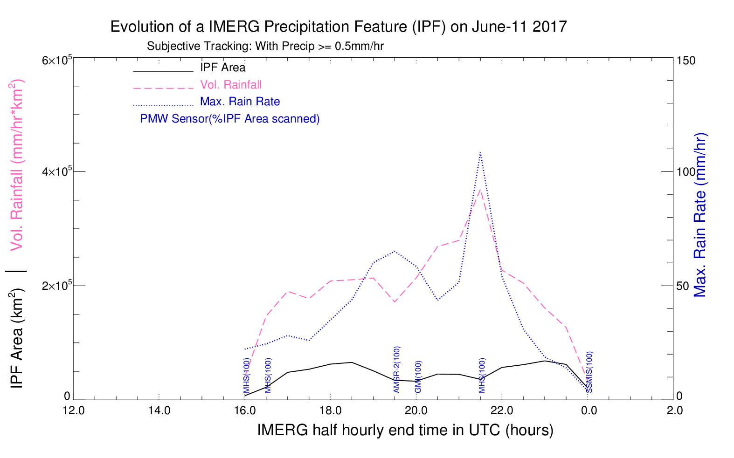
June 11th - IPF Evolution - 0.5 mm Threshold Subjective Method
During DC-8 flight in this system, upscale growth in rain volume while area changes little.

Slide 11
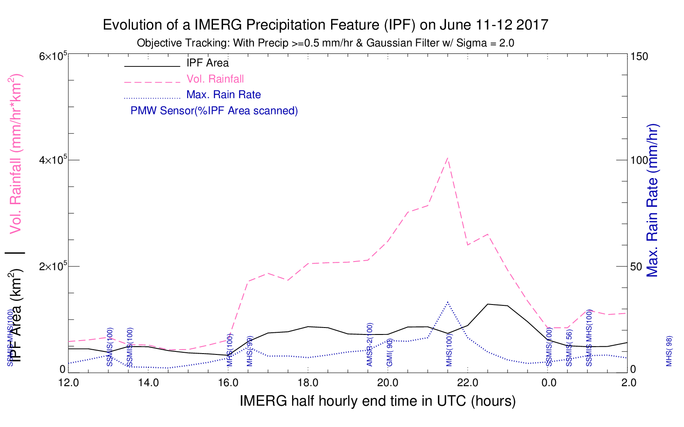
June 11th - IPF Evolution - 0.5 mm Threshold Objective Method
Objective method has slightly higher rain volume but twice the area, due to splits and mergers with smaller nearby precipitating systems not sampled by the aircraft.
Notes:
The decrease in max rain rate is because of the smoothing of precipitation field. But has similar volumetric growth.
The objective method has twice the area from mergers, but similar Vol. rain rate.
This example and others show that Vol. rain rate is more useful parameter to define upscale growth.

Slide 12
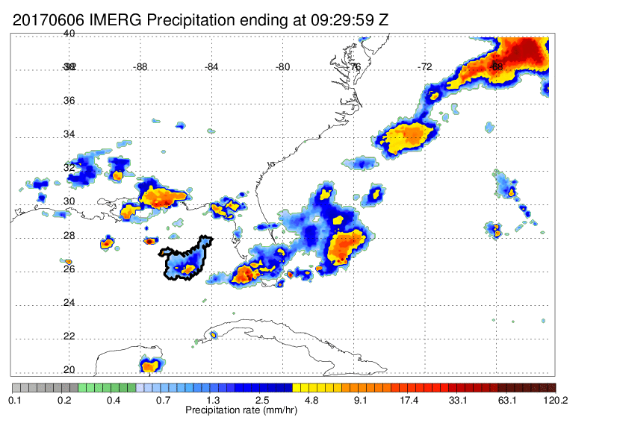
June 06th^{th} - IPF Evolution - 0.5 mm Threshold
Subjective
Objective
A clear example of a situation where the goal was the investigation of the growing, strong system in the Gulf of Mexico; the subjective approach can define that portion of the system, while the objective system insists on including the large precipitation areas over Florida and over the west Atlantic.
Notes:
Now lets look at the complex case of June 6th with multiple splits and mergers.
Clearly we could see Objective method include to more precipitation area.
Important point I want to make is that
Changing the precipitation threshold changes the system boundary.
As mentioned earlier there are two tunable parameters and
We are working to find an optimal precipitation threshold and smoothing radius so that the algorithm

Slide 13
June 06th^{th} - IPF Evolution - 0.5 mm Threshold
Subjective
Objective
A clear example of a situation where the goal was the investigation of the growing, strong system in the Gulf of Mexico; the subjective approach can define that portion of the system, while the objective system insists on including the large precipitation areas over Florida and over the west Atlantic.

Slide 14
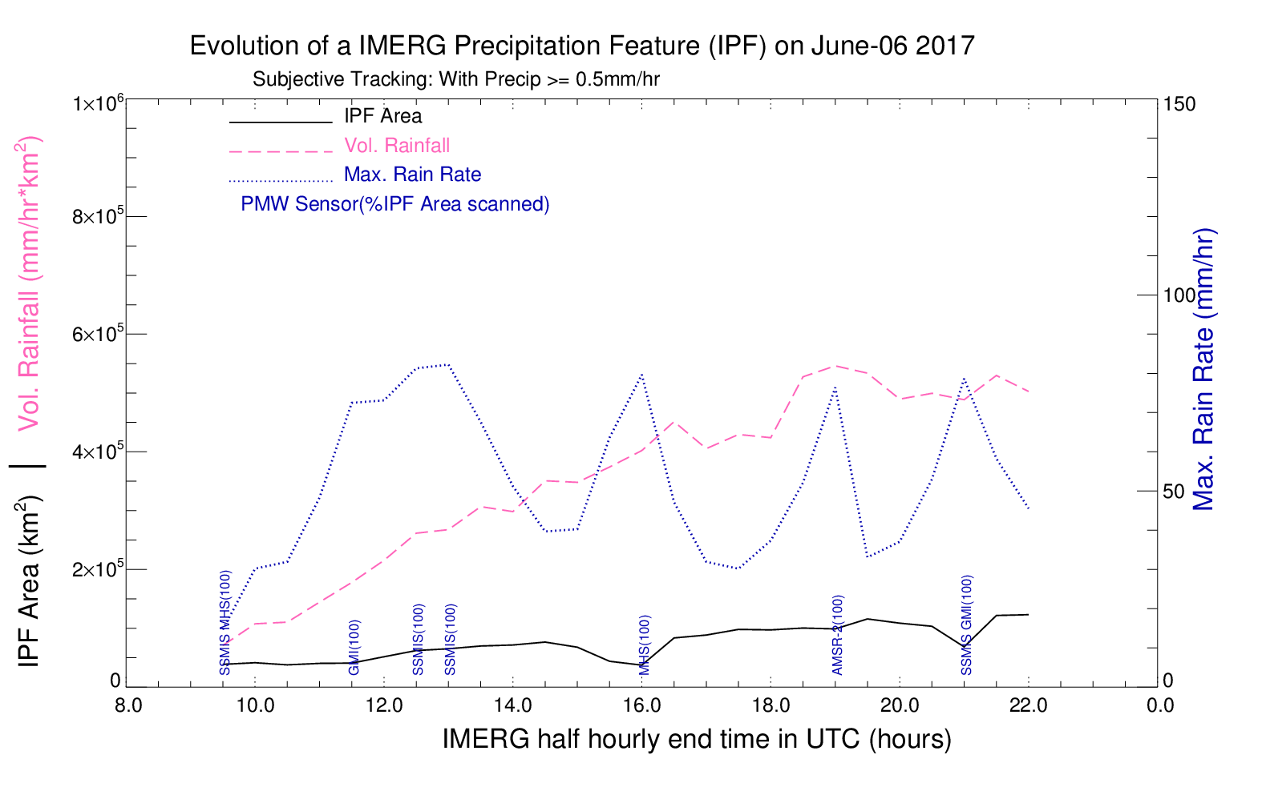
June 06th - IPF Evolution - 0.5 mm Threshold Subjective Method
Aircraft arrived at 19Z , near peak in rain volume about 0.55 x 10⁶ mm/hr * km².
Area of IPF around 1.0 x 10⁵ km² so mean rain rate about 5.5 mm/hr – lots of strong convection at that time.
Notes:
Looking at the system parameters between Subjective and Objective method.
There is a growth in both the methods. But looking closely at 19Z
The subjective method has rain vol of 0.55 x 10^6 and area of 1.0 10^5
And objective method has 4 times the volume and 5 times the area compared to subjective method.
Reason is that objective method include more precipitation area. And we are working to find the optimal value for the parameters that control the object boundary

Slide 15
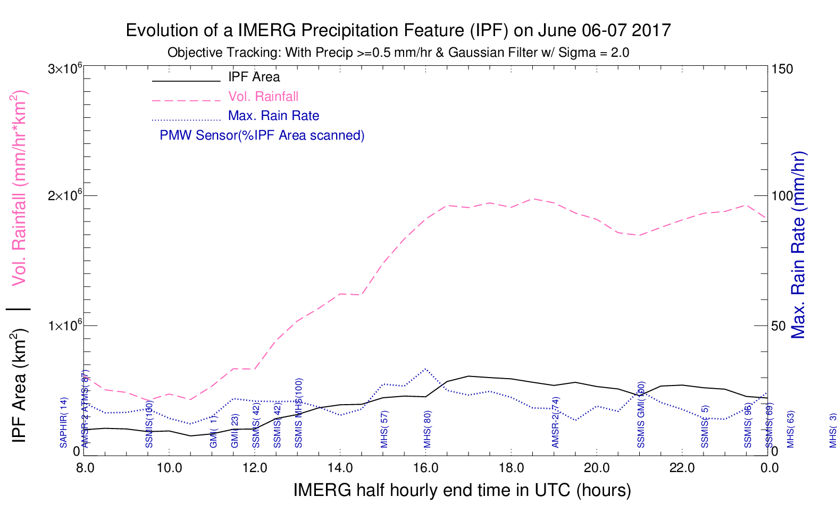
June 06th - IPF Evolution - 0.5 mm Threshold Objective Method
Shows growth in area and rain volume, but includes many systems under one IPF.
At 19Z rain volume ~ 2.0 x 10⁶ mm/hr * km². (~ 4 times subjective method)
Area of IPF ~ 5.5 x 10⁵ km^{2.} (~ 5 times subjective method)
Algorithm includes large area outside of area of interest of the flight mission

Slide 16
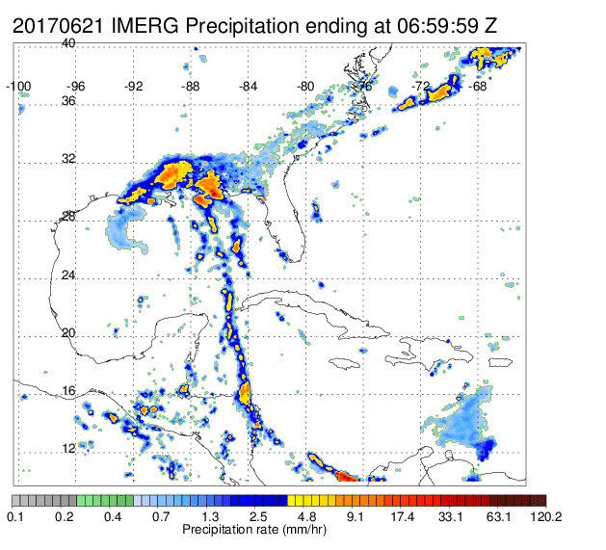
June 21- TC Cindy - IPF Evolution - 0.5 mm Threshold
Subjective
Objective
Focus of flight was inner core of the tropical cyclone; easy to define this central core subjectively, but because this precip region is connected to much larger precip region the objective method includes too much for our purpose.
Notes:
Cindy is another example of complex splits and merger.
We might be interested in the core / rainband of the cindy and the objective method include too much.

Slide 17
Summary
Objective tracking of upscale growth can work well for simple systems but for complex systems we need further study to tune the parameters and find optimal values.
Rain volume is a more appropriate measure of upscale growth than area, and is somewhat less sensitive to the minimum rain rate threshold chosen.
Notes:
a) Subjective and Objective tracking of upscale growth can work well for simple systems but the larger the MCS, and the more complex, it can become very difficult to decide the most appropriate size of the MCS at any given time b) Rain volume is a more appropriate measure of upscale growth than area, and is somewhat less sensitive to the minimum rain rate threshold chosen c) Small, and simple MCSs are most easily studied by a single aircraft mission, but require excellent forecasting if the start of the upscale growth period is to be sampled d) The most important cases of upscale growth are often associated with large synoptic scale disturbances; but their very size and complexity can be a major challenge to cover with a single aircraft. Among the lessons learned during CPEX: • it may be necessary to choose between sampling the interior convection, or obtaining environmental data on the inflow or outflow environment, especially if doing so requires cloud-free conditions below the aircraft

Slide 18
June 17th – Upscale growth of large, complex MCS within major tropical disturbance during DC-8 mission: Many lessons learned

Slide 19
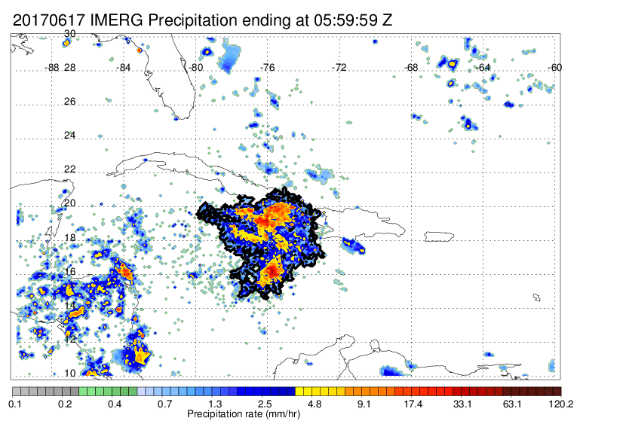
June 17th^{th} - IPF Evolution - 0.5 mm Threshold
Subjective
Objective
Evolution of June 17th case – Upscale growth begins before aircraft arrival; but maximum growth rate is during the mission, by either method or any rain rate threshold

Slide 20
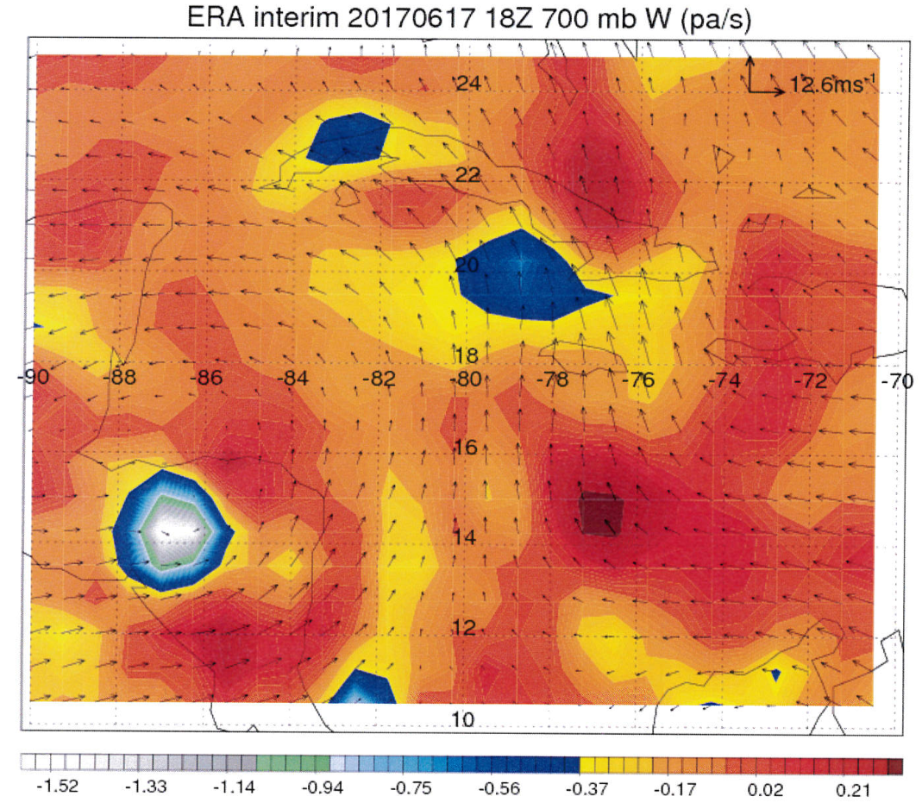
June 17th - Large Scale Environment
MCSs continually form and decay in the low-level convergent flow in the NE quadrant of the central American gyre, which has been intensifying in place for 2-3 days.

Slide 21
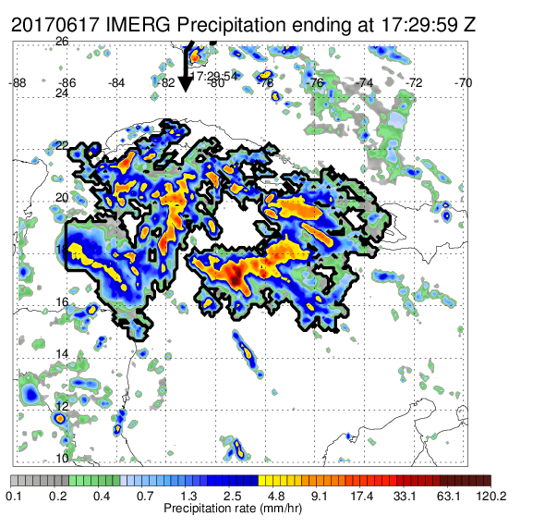
June 17th^{th} IMERG PF vs GMI PF (GPM overpass covers area of interest just before DC-8 arrival)
IMERG PF with 0.1 mm/hr Threshold
GMI PF @ 17:25 Z with 0.1 mm/hr Threshold
Thanks to Dr. Chuntao Liu
As expected, IMERG is almost identical to GMI rain rates for time closest to overpass

Slide 22
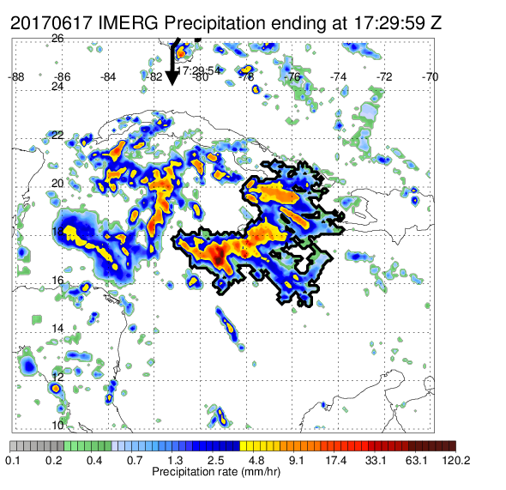
June 17th^{th} IMERG PF (0.3 mm/hr) vs GMI PF
IMERG PF with 0.3 mm/hr Threshold
GMI PF @ 17:25 Z with 0.1 mm/hr Threshold
Thanks to Dr. Chuntao Liu
Note the change in IMERG PF boundary; change to 0.3 mm/h severs western half of precipitation area from the IPF. For the objective method (not shown) the two areas are retained for 0.3 mm/h but severed at 0.5 mm/h minimum rain rate.

Slide 23
June 17th^{th} IMERG PF (0.3 mm/hr) vs GMI PF
IMERG PF with 0.3 mm/hr Threshold
GMI PF @ 17:25 Z with 0.1 mm/hr Threshold
Thanks to Dr. Chuntao Liu
Note the change in IMERG PF boundary; change to 0.3 mm/h severs western half of precipitation area from the IPF. For the objective method (not shown) the two areas are retained for 0.3 mm/h but severed at 0.5 mm/h minimum rain rate.

Slide 24
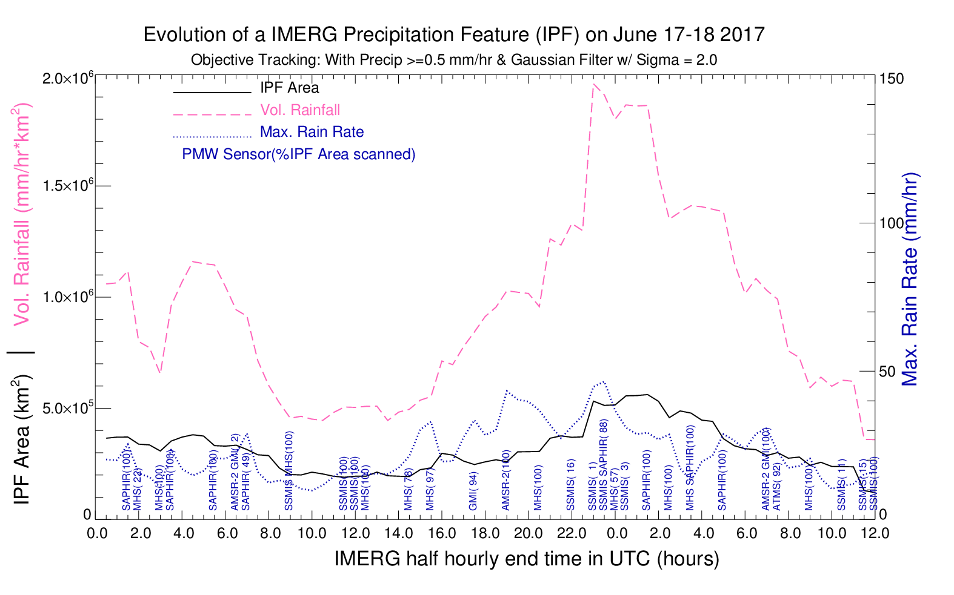
June 17th - IPF Evolution - 0.5 mm Threshold Objective Method
Independent of threshold choice and tracking method, there is very strong upscale growth in the specific region sampled by the DC-8 during the period from ~ 1800 – 2200 UTC

Slide 25
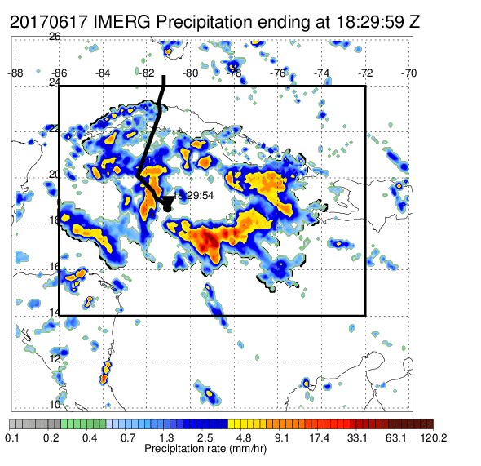
June 17th - Upscale Growth during flight hours
Small domain
Larger Domain
The area sampled during the flight fills up with convection.

Slide 26
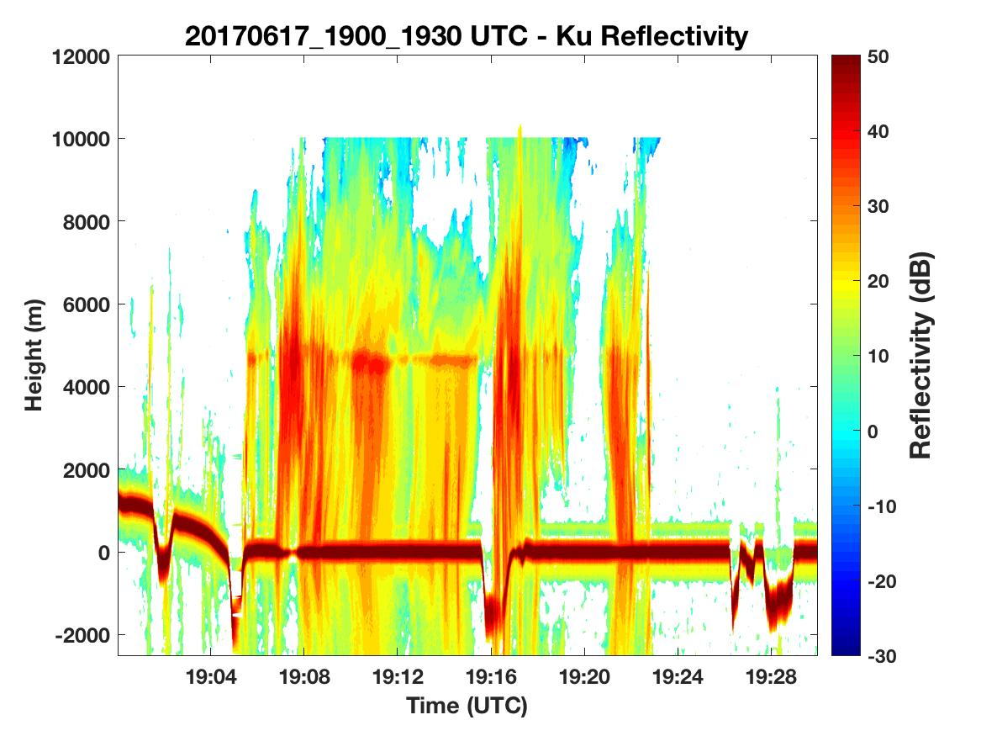
June 17th - Closer look at the upscale growth
Aircraft track and dropsondes
APR-2
APR-2: Dark red band represent surface, wiggles show the aircraft turns.

Slide 27
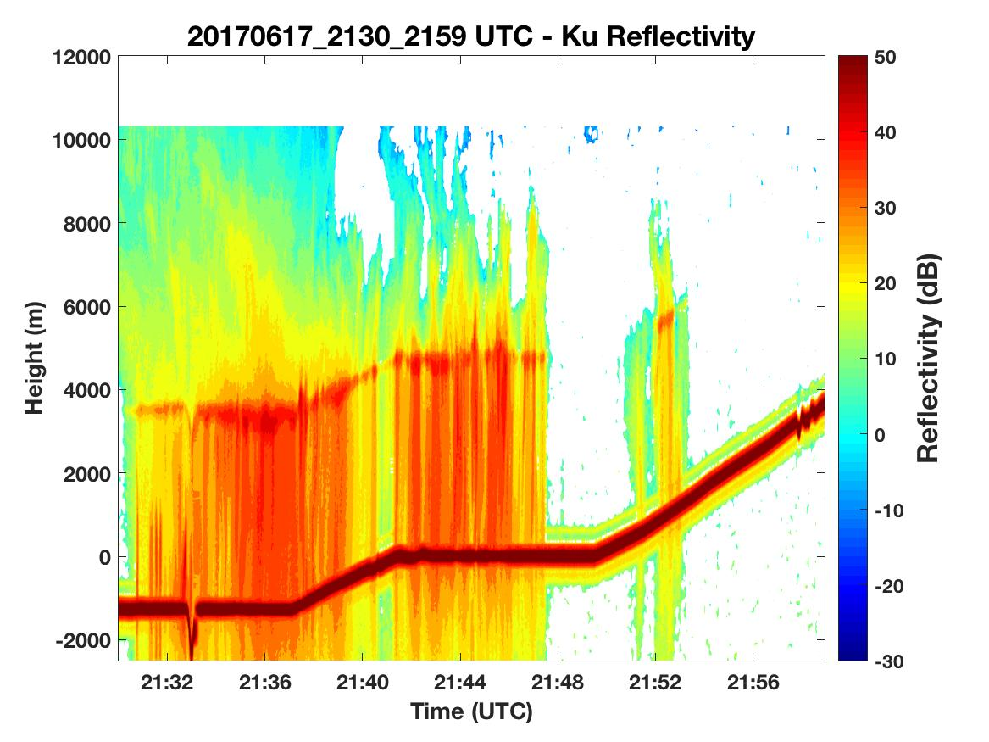
June 17th - Closer look at the upscale growth
Aircraft track and dropsondes
APR-2
Convection and stratiform precipitation filling up the sampled area

Slide 28
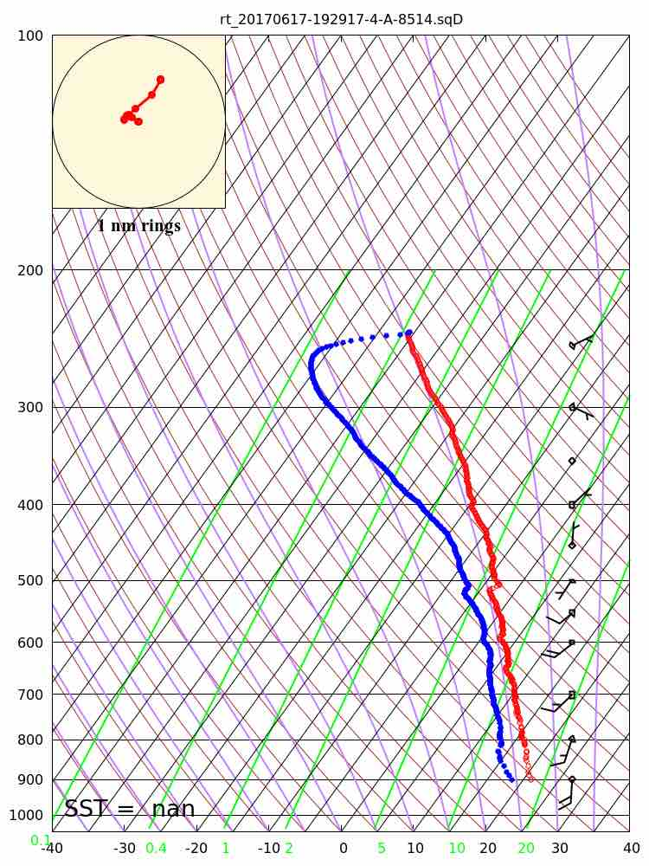
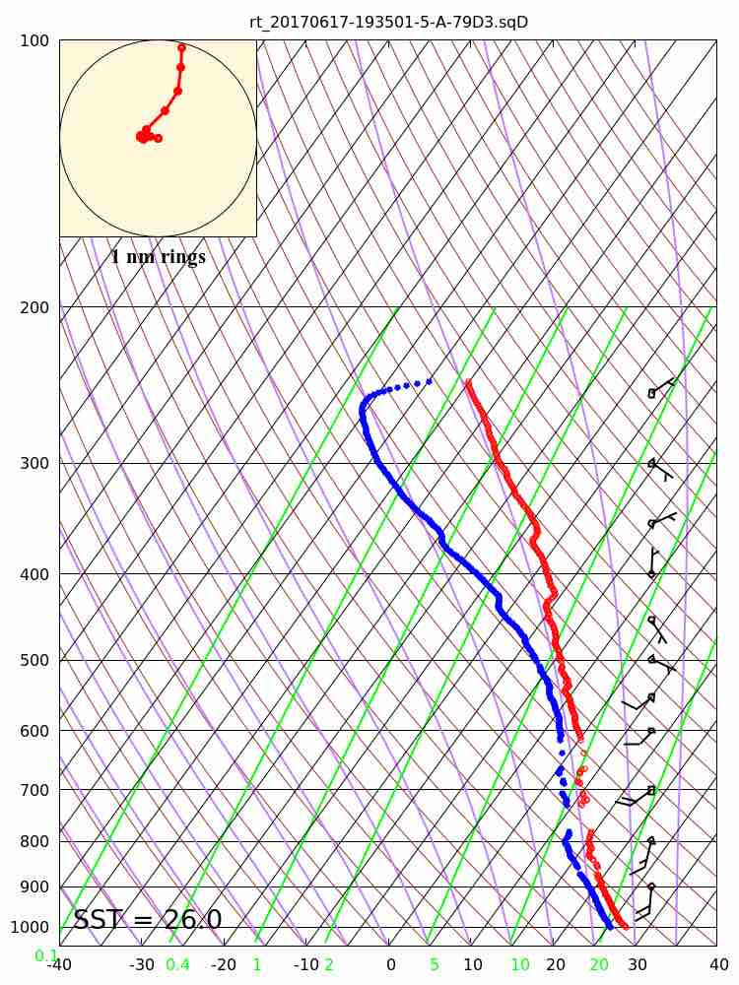
June 17th - Dropsonde 5 & 6
Thanks to Steve Greco and Mark Beaubien
In spite of intentionally planning flight legs outside of radar echoes, the rapid upscale growth compromised obtaining good data from DAWN and dropsondes; these two sondes were the ONLY ones with good data below melting level

Slide 29
Summary
Objective tracking of upscale growth can work well for simple systems but for complex systems we need further study to tune the parameters.
Rain volume is a more appropriate measure of upscale growth than area, and is somewhat less sensitive to the minimum rain rate threshold chosen.
Small, and simple MCSs are most easily studied by a single aircraft mission, but require excellent forecasting.
The more complex systems are often associated with large synoptic scale disturbances; but their very size and complexity can be a major challenge to cover with a single aircraft
Among the lessons learned during CPEX: For large MCSs it may be necessary to choose between sampling the interior convection, or obtaining environmental data
Notes:
a) Subjective and Objective tracking of upscale growth can work well for simple systems but the larger the MCS, and the more complex, it can become very difficult to decide the most appropriate size of the MCS at any given time b) Rain volume is a more appropriate measure of upscale growth than area, and is somewhat less sensitive to the minimum rain rate threshold chosen c) Small, and simple MCSs are most easily studied by a single aircraft mission, but require excellent forecasting if the start of the upscale growth period is to be sampled d) The most important cases of upscale growth are often associated with large synoptic scale disturbances; but their very size and complexity can be a major challenge to cover with a single aircraft. Among the lessons learned during CPEX: • it may be necessary to choose between sampling the interior convection, or obtaining environmental data on the inflow or outflow environment, especially if doing so requires cloud-free conditions below the aircraft

Slide 30
Thank You! Comments and questions welcome

Slide 31
Extras!

Slide 32
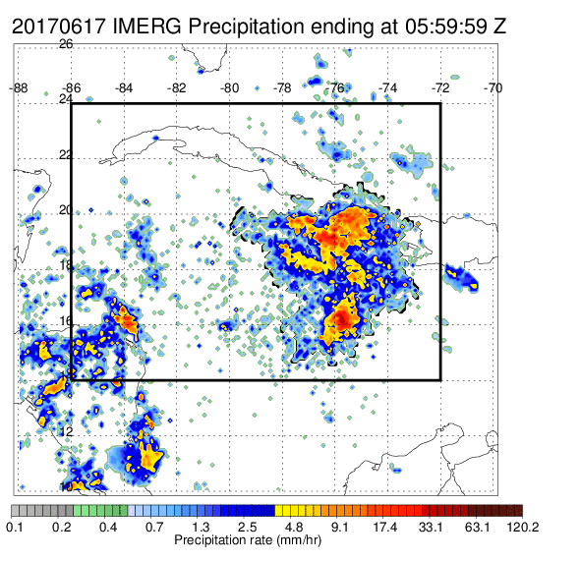
June 17th - Upscale Growth during flight hours
Subjective
Objective
C:

Slide 33
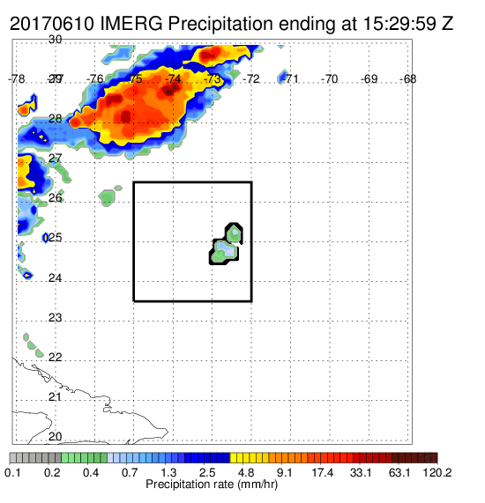
June 10th - IPF Evolution - 0.3 mm Threshold Subjective Method
Subjective
Objective
C:

Slide 34
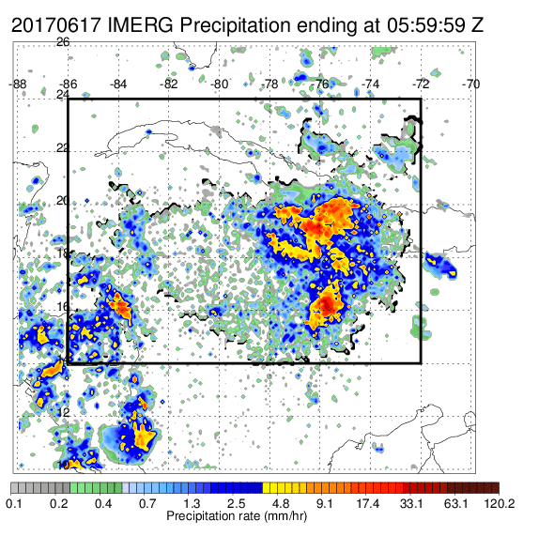
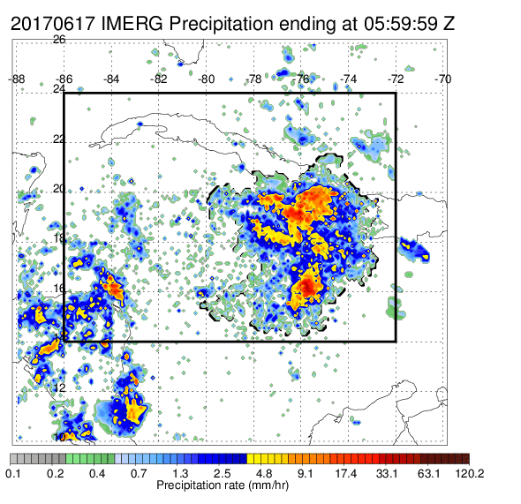
June 17th^{th} - IPF Evolution - Subjective What is the optimal Precipitation Threshold?
0.1 mm/hr
0.3 mm/hr
0.5 mm/hr
Different threshold, create different IPF area/rain volume, because the light precipitation connects the moderate/high precipitating area.

Slide 35
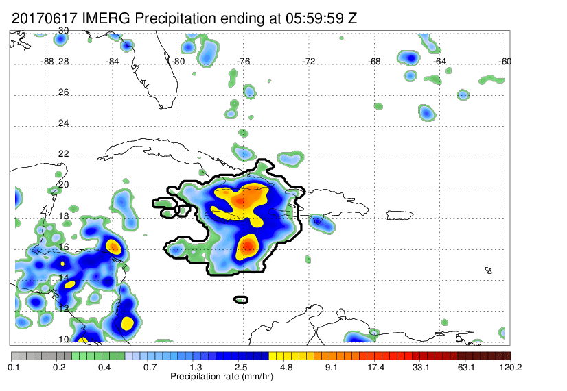
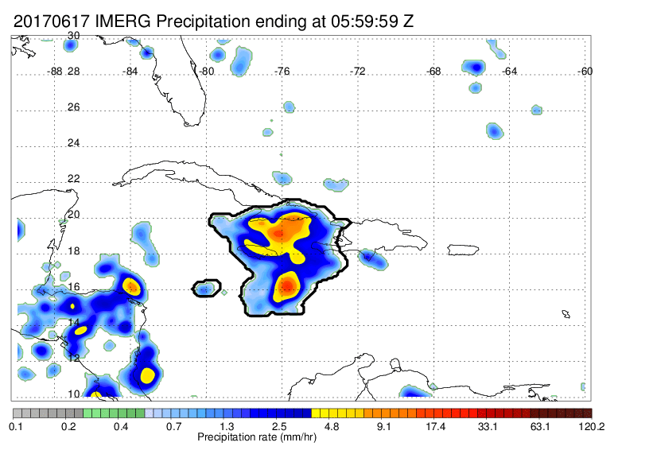
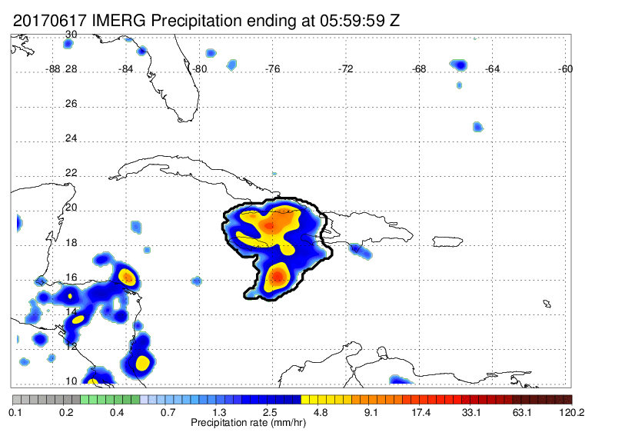
June 17th^{th} - IPF Evolution - Objective What is the optimal Precipitation Threshold?
0.3 mm/hr
0.5 mm/hr
1.0 mm/hr
Different threshold, create different IPF area/rain volume, because the light precipitation connects the moderate/high precipitating area.

Slide 36
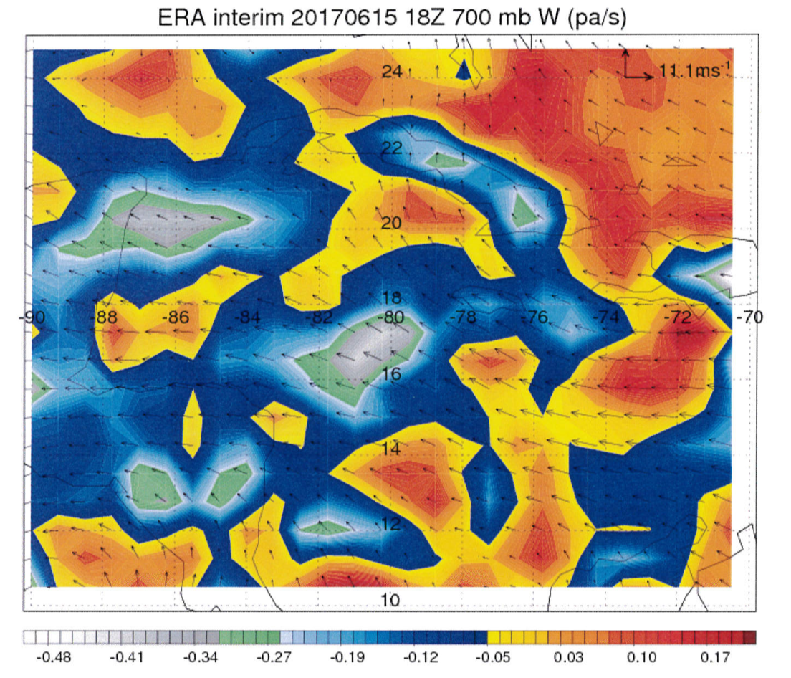
June 15th - Synoptic Conditions

Slide 37
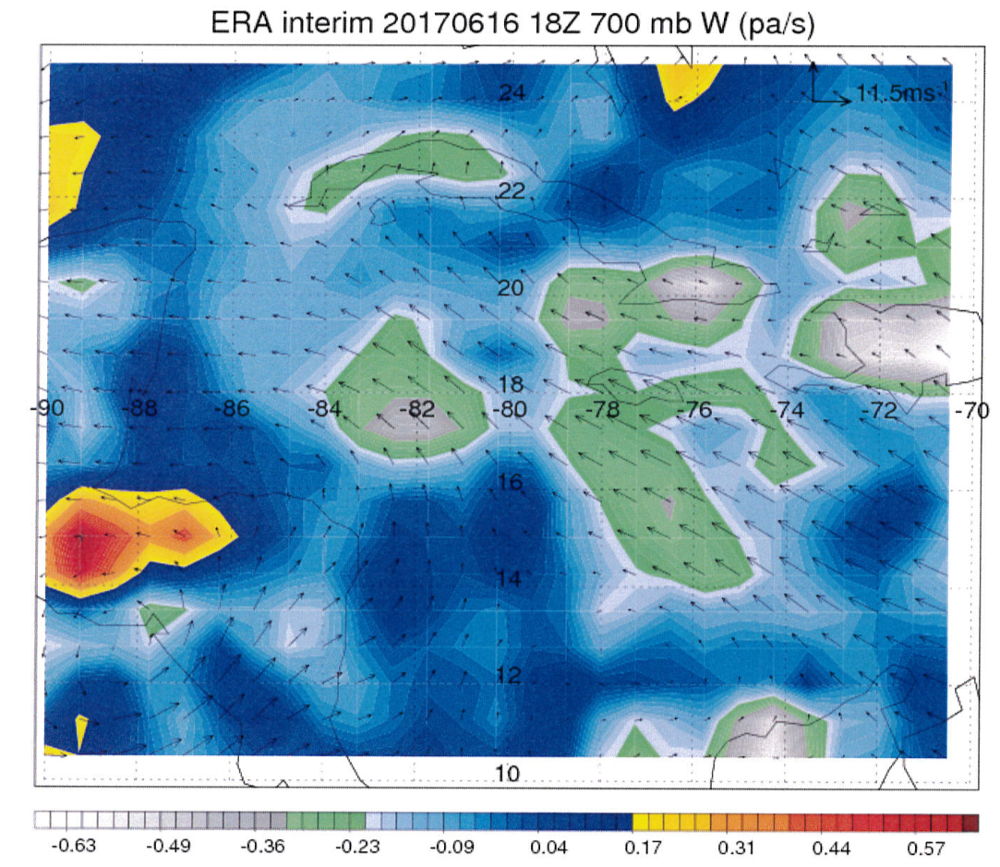
June 16th - Synoptic Conditions

Slide 38
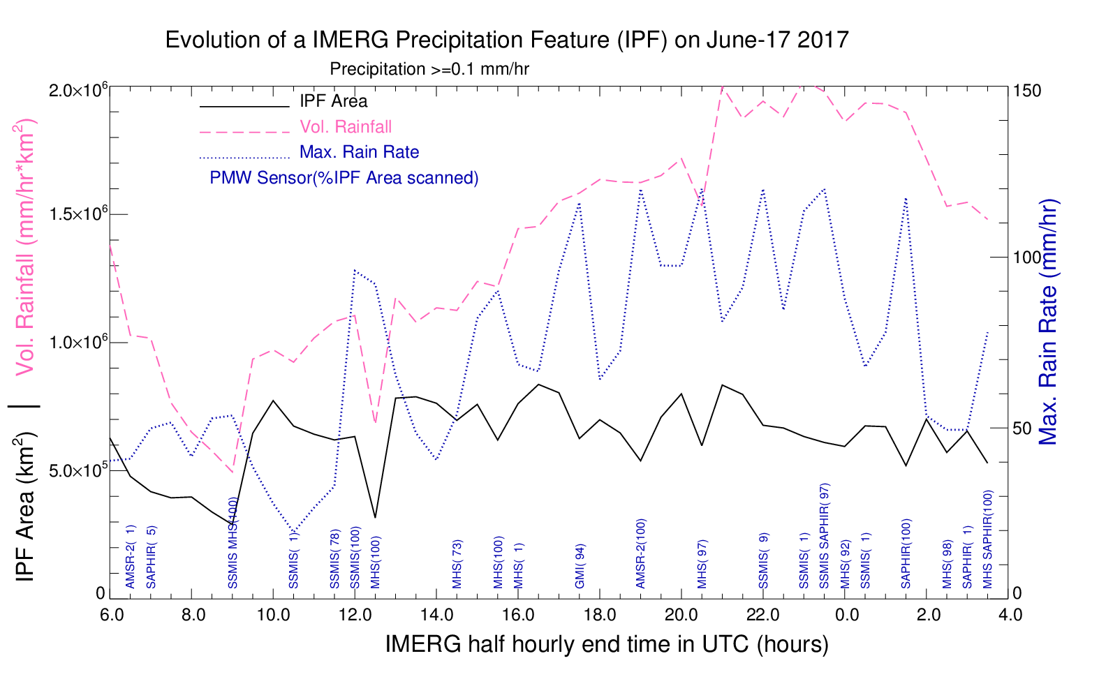
June 17th - IPF Evolution - 0.1 mm Threshold Subjective Method
Rain Volume about 1.6 x 10⁶ mm*km²/hr
IPF Area about 6.4 x 10⁵ km²

Slide 39
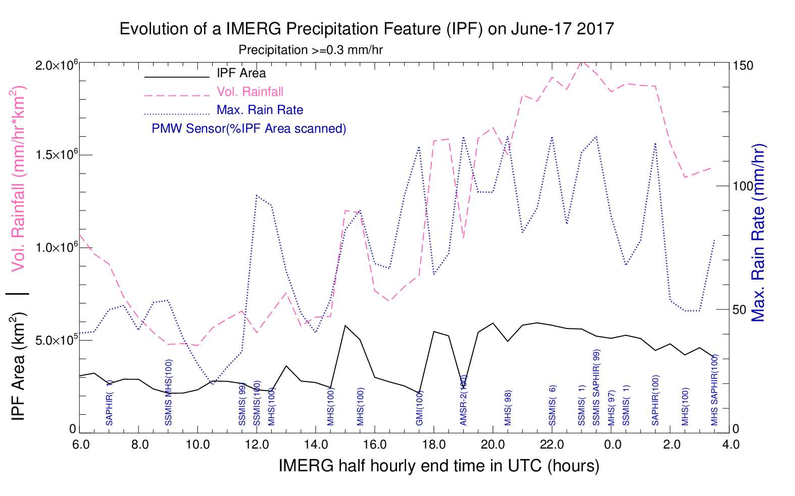
June 17th - IPF Evolution - 0.3 mm Threshold Subjective Method
Rain Volume about 0.85 x 10⁶ mm*km²/hr (reduced by nearly half)
IPF Area about 2.1 x 10⁵ km² (reduced by nearly one-third )
Independent of threshold choice, there is an upscale growth.

Slide 40
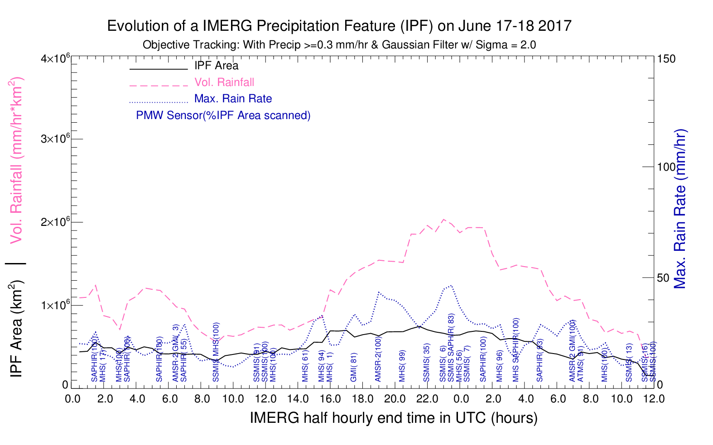
June 17th - IPF Evolution - 0.3 mm Threshold Objective Method
Rain Volume about 1.4 x 10⁶ mm*km²/hr
IPF Area about 6.5 x 10⁵ km²

